Slide 1
Hierarchical Clustering
A different kind of clustering method
Arranges the whole data set into “nested” clusters
Can be shown visually in a tree structure
How it works: each point starts as its own cluster (n data points → n clusters)
Repeatedly merge the two most similar clusters into a single cluster
After each step, we have one fewer cluster, because two clusters have merged together

Slide 2
Distance Between Clusters
Easy!
?
Not as easy

Slide 3
Distance Between Clusters
Four common approaches to measure distance:
Single linkage: uses the pair of points from the clusters with the smallest distance between them
Complete linkage: uses the pair of points from the clusters with the greatest distance between them
Group average linkage: takes the average distance of all possible pairs of points
Centroid method: uses the distance between the centroids of the two clusters

Slide 4
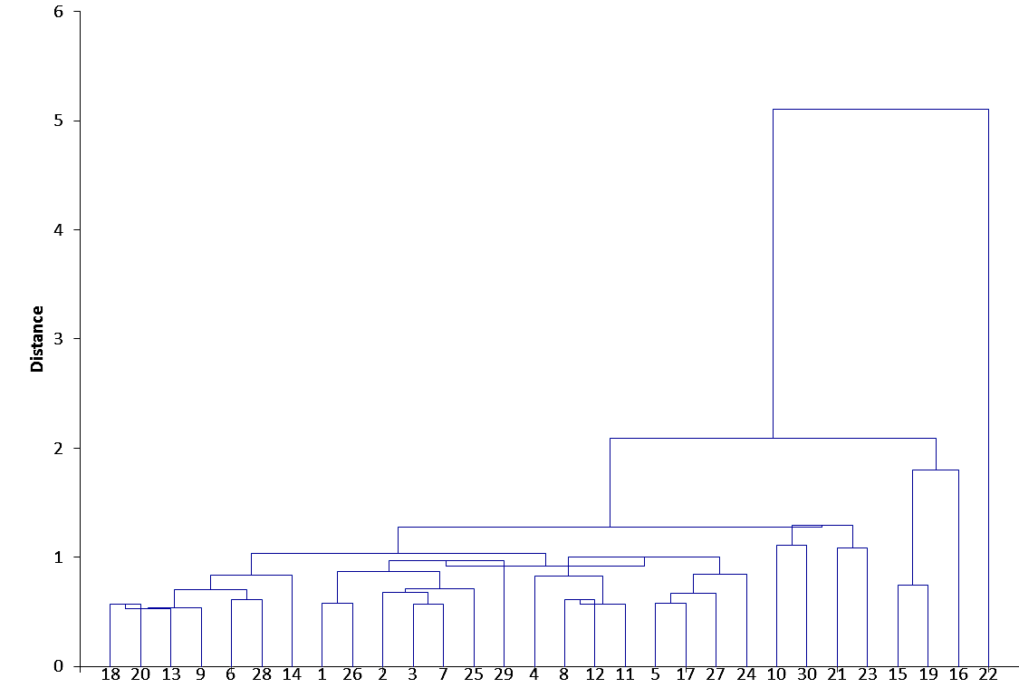
Dendrogram
The output from hierarchical clustering is a dendrogram
Displays clusters and distances between them

Slide 5
Dendrogram
The height of a bar represents the distance between the two clusters being merged.
The idea is not to merge clusters that are very far apart.

Slide 6
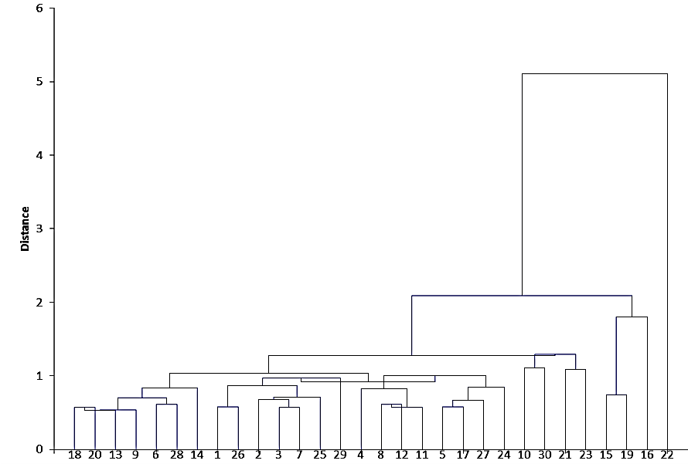
Can Obtain Any Number of Clusters
Two clusters
Four clusters

Slide 7
Which Clustering Method to Use?
Factors in favor of k-means
Factors in favor of hierarchical
Specific number of clusters desired
Prototype points desired
Ease of interpretation is important
Number of clusters is unknown
If identifying outliers is important
If a general sense of the structure of the data points is useful
There might not always be a clear winner
Can do both
Hierarchical clustering can help determine k

Slide 8
What Is an Association Rule?
Given that a data point has certain traits, how likely is it to have some other trait?
If/then statements:
If a house is above 2000 sq. ft. and has a two-car garage, then its probability of having a swimming pool is 0.22.
0.22 is the confidence of the association rule
premise/antecedent/lhs
conclusion/consequent/rhs

Slide 9
What Is an Association Rule?
If a house is above 2000 sq. ft. and has a two-car garage, then its probability of having a swimming pool is 0.22.
But how many houses have two-car garages?
Are houses with two-car garages more likely to have swimming pools?
How likely is this house to be near good schools?
Lots of questions we could ask!

Slide 10
Association Rule Metrics
We will look at three metrics:
Support
Confidence
Lift ratio

Slide 11
Shopping Cart
Transaction | Shopping cart
1 | yogurt, bread, peanut butter, milk, fruit, jelly
2 | jelly, soda, milk, fruit, vegetables, bread, peanut butter
3 | whipped cream, fruit, chocolate sauce, beer
4 | steak, jelly, soda, bread, fruit
5 | jelly, soda, peanut butter, milk, fruit
6 | jelly, soda, milk, bread, fruit
7 | fruit, soda, milk, popcorn
8 | fruit, soda, peanut butter, milk, vegetables
9 | fruit, cheese, yogurt
10 | vegetables, yogurt, beer

Slide 12
Support
The support of an item or set of items is the proportion of data points for which it occurs.
In the shopping cart example, the support of {milk} is 0.6.
The support of {milk, bread} is 0.3.
Confidence can be written as:
support of {premise, conclusion} support of {premise}

Slide 13
Limitation of Confidence
Issue: consequents with high support will always yield high confidence for the association rule
Beatles and Bach problem

Slide 14
Lift Ratio
Lift ratio is a way to resolve this problem
Lift ratio:
Confidence Support of conclusion
“New probability” “Original probability”
Lift ratio is the factor by which the premise increases the probability of the conclusion

Slide 15
Interpreting Lift Ratios
Association rule: “If two-car garage, then swimming pool”
Lift ratio = 2.4
A house with a two-car garage is 2.4 times more likely to have a swimming pool
Lift ratio = 0.7
A house with a two-car garage is 0.7 times as likely (30% less likely) to have a swimming pool
Lift ratio = 1
A house with a two-car garage is just as likely as any other house to have a swimming pool

Slide 16
Sorting and Filtering
Invaluable when working with association rules (especially when the number of items is large)
Can filter based on metrics
For example, if we only want to see rules above a minimum support and confidence
Sorting makes it easy to identify rules with high confidence, lift ratio, or support
Also easy to find rules involving a specific item or set of items
Notes:
(Go over the R code dealing with sorting & filtering, and the results)

Slide 17
Using Association Rules
Support, confidence, and lift ratio are all helpful
Value depends on context and what will be done with the information

